Slide 1
Sexual Violence Prevention Education
… Providing Services in southern Kane County, Kendall County and surrounding areas for Victims of Domestic Violence and Sexual Assault
24 hour emergency shelter and hotline
Counseling individuals and families affected by sexual and domestic violence
Prevention Education
Hospital Advocacy
Legal Advocacy
Middle & High School Faculty and Staff
Sexual Violence Prevention In-Service

Slide 2
Objectives
Erin’s Law: Why sexual violence prevention programs are necessary
Mutual Ground Curriculum: Program details
Collaboration: How Teachers and MGI Prevention Educators will work together to provide quality remote learning
Abuse Disclosures: How to handle student disclosures

Slide 3
Why Sexual Violence Prevention Programs Are Necessary?
Sexual abuse happens to people of all genders, races, religions & socioeconomic groups
1:4 girls and 1:6 boys will be victimized by their 18th birthday.
Median victim age is 9
When victim is under 18…
39% of the time the abuser is a family member
93% of offenders are known to victims
67% of all sexual crimes happen to children under 17
Parents don’t always teach this topic to their children
Only 30% of parents report teaching children about sexual violence

Slide 4
Erin’s Law Requires
Children...
Grades PreK-12 in public schools, receive education on sexual abuse prevention through age appropriate curriculum
Provide children the tools to Recognize, Refuse and Report sexual violence
Provide children with the tools to speak up and tell someone about sexual violence rather than keep it a secret
Educate children on safe touch vs. unsafe touch and safe secrets vs. unsafe secrets
Parents and Educators…
Educators will be trained on the prevention of sexual violence
Parents will be provided information on characteristics of offenders, grooming behaviors and how to discuss this topic with their children
Notes:
Recognize, Refuse, Report

Slide 5
Why Do We Do Our Programs?
Erin’s Story
https://www.youtube.com/watch?v=vcISu0q4qUA

Slide 6
Goal 1: Educate
Define Consent:
Personal Boundaries
Freely Given
Revocable
Agreement
Identify Private Parts:
Breasts
Vagina
Penis
Anus
Mouth
Explain Sexual Abuse Laws:
Sexual Harassment
Molestations
Rape
Incest
Exploitation
Non-Touch crimes
Identify Illegal Behaviors
Repeatedly make someone uncomfortable
Sexual behaviors without consent
Notes:
Missing anything under consent?
Add non-touch under SA Laws?
Depending on the program your students receive, different topics are covered in an age-appropriate manor broken down on an upcoming slide.

Slide 7
Goal 2: Inform
Tricks Abusers Use:
Trust
Grooming
How Victims React to Abuse:
Fight
Flight
Freeze
Negotiate
How Abuse Hurts Victims:
Emotional
Physical
School
PTSD
Why Abusers Abuse:
Power
Control
How to Get Help:
Get Away
Go to the hospital, if necessary
Tell a trusted adult
Notes:
Add anything else under tricks?
Add negotiate based on current trainings?

Slide 8
Goal 3: Empower
Grant them ownership of their body and setting personal boundaries
Give them permission to say “no” to uncomfortable or undesirable behaviors
Encourage them to help others who have been abused
Develop an understanding of how to get help
Never too late to tell
Not their fault
Legal rights

Slide 9
Curriculum Format:
Middle School
6th Grade: Sexual Harassment
7th Grade: Sexual Abuse
8th Grade: Healthy Relationships
High School
9th Grade: Dating Abuse & Sexual Assault
10th Grade: Rape Culture & Victim Blaming
11th Grade: Bystander Intervention
12th Grade: Next Steps

Slide 10
Private Room
Offers a safe place for students to ask questions and talk about sexual abuse
Students will be given a time and place to meet privately with a Mutual Ground staff member
Confidential hotline number will also be given to students and staff
Offered to students 12 and older
Students over the age of 12 have the right to confidentiality with three exceptions
* Threaten to harm self
* Threaten to harm someone else
* Disclosure of abuse by a caretaker (parent, step-parent, teacher, coach,
babysitter)

Slide 11
What is Child Sexual Abuse?
Molestation-someone touching a child’s private parts or forcing child to touch theirs
Rape-forced penetration
Child pornography
Grooming
Commercial sexual exploitation of children

Slide 12
Signs that a child may have been sexually abused
Physical Signs
Sexually transmitted infections
Bruising or swelling near the genital area
Broken bones/repeated unusual injuries
Difficulty in walking or sitting
Behavioral Signs
Excessive talk about or knowledge of sexual topics
Regressive behavior
Sexual behavior that is inappropriate for the child’s age
Emotional Signs
Self-harming behaviors
Excessive worry or fearfulness
Loss or decrease interest in school, activities and friends
Notes:
It’s not always easy to spot sexual abuse because perpetrators often take steps to hide their actions. Some signs may be easier to spot than others. Here are a few examples of some of the common signs that could indicate a child is being abused.

Slide 13
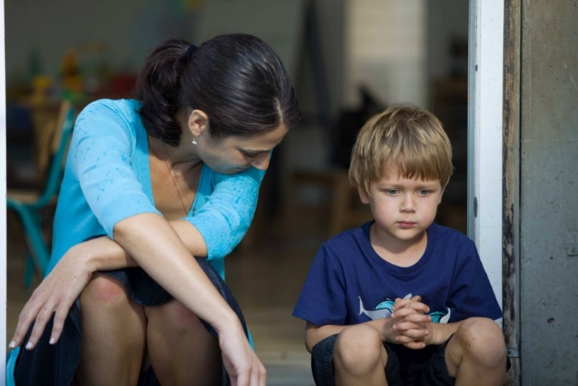
What you should do if a child discloses…
Remain Calm
Praise the child by reassuring them they did the right thing by telling
Do not interrogate the child for information or ask leading questions
Make the child as comfortable as possible
Be patient
Reassure the child that it is not their fault
Respect confidentiality
Do not disclose your own abuse to the child
Report to DCFS/Police
Recommend resources for counseling
Notes:
It is important to remain calm after a child has disclosed abuse. The child is often looking for ways in which the adult is going to respond. Also be aware of your tone. IF you start the conversation in a serious tone , you may scare the child. A non-threatening tone will help put the child at ease.
Continue to praise the child and reassure them that they did the right thing by telling
Do not ask leading questions. Talk to the child using their vocabulary. A good way to do this is to go back and reference the safety rule.
Reassure the child that they have done nothing wrong and this is not their fault.
Be patient. Remember that this conversation may be very frightening for the child. Many perpetrators make threats about what will happen to them if someone finds out about the abuse.
Report the disclosure. DCFS if the perpetrator is in a caretaker role or lives in the house with the child. Police for anyone else ex. Neighbor or another child
Respect the child’s confidentiality. Talk to those who only need to be involved (Principal, DCFS, Police)
Recommend resources for counseling. Mutual Ground’s contact info will be at the end of this presentation along with other helpful resources.

Slide 14
The Role of a Mandated Reporter
Mandated Reporters- All School Staff
Mandated reporters are required to report suspected child abuse or neglect immediately when they have “reasonable cause to believe” that a child known to them in their professional or official capacity may be an abused or neglected child. (325 ILCS 5/4)
Reports must be confirmed in writing (CANTS form) to the local investigation unit within 48 hours of the Hotline call.
Telling your social worker/ principal does not relieve you of the duty to call DCFS. The person who took the disclosure should call DCFS.
No one within your employment setting is permitted to forbid you from calling.
DCFS Hotline is available 24 hours per day, seven days per week, 365 days a year. 1-800-252-2873 (1-800-25-ABUSE)
Notes:
Read through slide

Slide 15
What should be reported…
Any time a child reports sexual violence- which includes:
someone touching their private parts
the child touching someone else’s private parts
sexual photos/ texts/videos
being asked to watch pornography
being asked to watch sexual activity
being told to engage in sexual activity with another person/child
A child states that another child has been abusing them
An adult discloses that he or she has abused a child
A child being coerced to touch someone else
Notes:
Read through slide

Slide 16
For more information, please review the For Teachers section of our website: www.mutualgroundlearning.com
Questions about your school’s programming?
Contact Tina Bleakley, Prevention Education Department Manager at 630-897-0084 ext. 137 or tbleakley@mutualground.org

